Slide 1
UN role in Formulation of International Law
Shamshad Ahmad Khan, PhD

Slide 2
United nations and IL (UN Charter)
Post WW II, LN was replaced by UN but had many institutional character similar to that of LN.
The UN declared use of force (War) illegal (1. except for self-defence (Article 51) and, 2. authorized by the UN)
https://www.un.org/en/about-us/un-charter/full-text
The holocaust prompted the UN to begin international promotion of Human rights.
Under the Westphalian ideas of sovereignty, the state could treat its own citizens in anyway it pleased.
But after WWII, the treatment by states to its own citizens/population under its control is an international issue (Myanmar and Rohingya issue, Israel and Palestine Issue)

Slide 3
The Universal Declaration of Human Rights ( 1948) outlines various rights including the right to life, liberty ad security of person,
International Law on Human Rights will be discussed separately.
The right to a standard of living adequate for the health and well being of himself and as of his family.
(Focus shifted from States to individuals)
Decolonization- formation of new independent states in Asia and Africa.

Slide 4
End of Cold War
During the Cold war period 1950s to 1989 ; period of relative peace (EXCEPT Korean and Vietnamese wars)
End of Cold war brought many problems: Iraq occupied Kuwait,
Internal crisis broke out in Yugoslavia: new states Bosnia-Herzegovina and Croatia.
IL- International criminal Tribunal formed aimed at bringing persons involved in Crime, Yugoslavian President was charged.
Similarly, Sudanese President was also convicted by a separate tribunal for unleashing atrocities in South Sudan.

Slide 5
9/11 and IL
Post September 11, 2001 attack on WTT, US resorted to its right to engage in ‘pre-emptive’ self defense to neutralize its enemies and terrorists.
The UN, however, does not allow this kind of pre-emptive war because it will encourage countries to start war against their rivals.
The US did not care and invaded Iraq in 2003.
US suffered with disrepute after its action in Iraq bypassing the UN. UN declared 2003 war “illegal”.
https://news.un.org/en/story/2004/09/115352

Slide 6
Do the Strong States make Int. Law or weak/small can also make Int Law?
Treaty on the Prohibition of Nuclear Weapons
https://treaties.un.org/pages/ViewDetails.aspx?src=TREATY&mtdsg_no=XXVI-9&chapter=26
U.N. Treaty Banning Nuclear Weapons Takes Effect, Without The U.S. And Other Powers
https://www.npr.org/2021/01/22/959583731/u-n-treaty-banning-nuclear-weapons-takes-effect-without-the-u-s-and-others

Slide 7
Treaty on the Prohibition of Nuclear Weapons
It prohibits nations from developing, testing, producing, manufacturing, transferring, possessing, stockpiling, using or threatening to use nuclear weapons, or allowing nuclear weapons to be stationed on their territory. It also prohibits them from assisting, encouraging or inducing anyone to engage in any of these activities.
https://www.icanw.org/why_a_ban

Slide 8
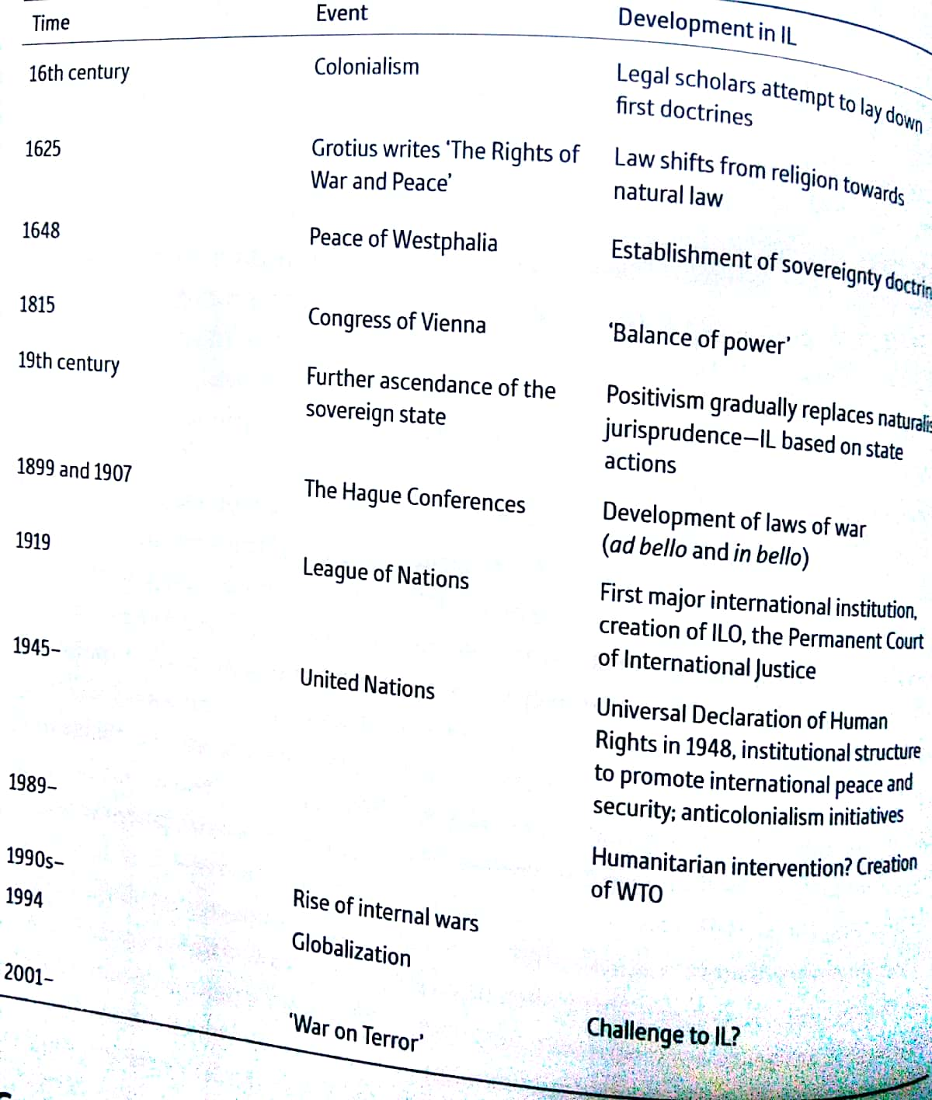
IL at a glance

Slide 9
Suggested readings
Basak Cali, Chapter 3, Basic Principles of International Law: A historical perspective in International Law for International Relations, Oxford University Press.
Jan Klabbers, Chapter 1, The setting of International Law, in International Law, Cambridge University Press.

